Slide 1
Style Transfer -from real photos to artworks
Liying Li
Jinghui Zhao

Slide 2
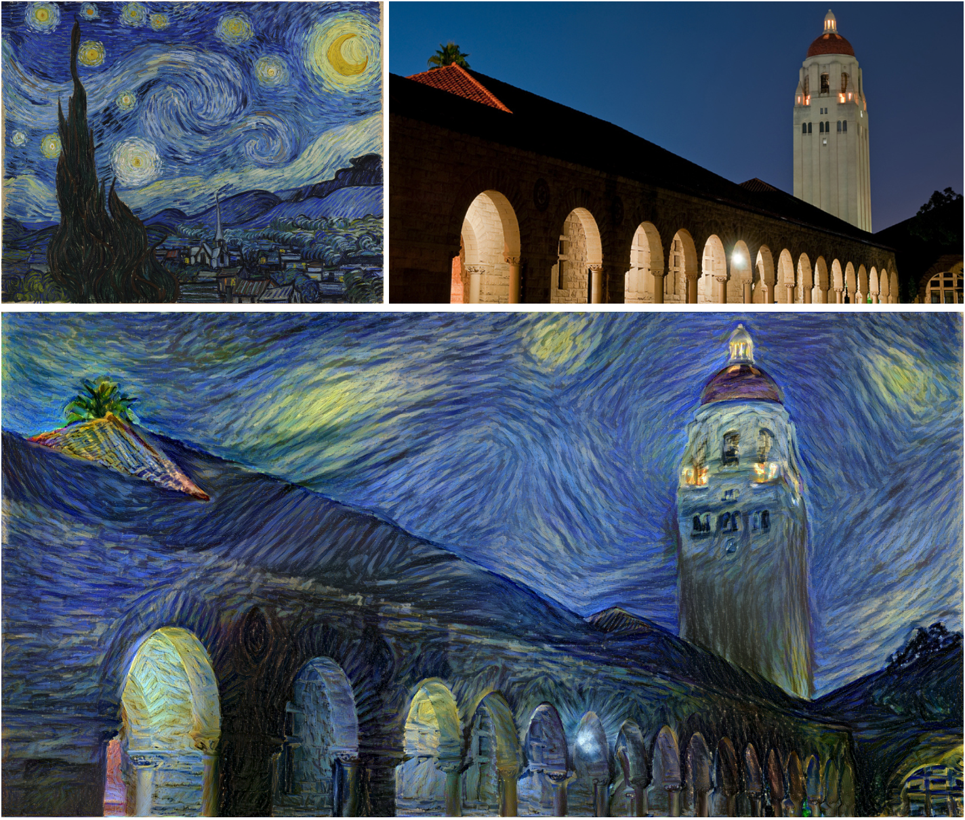


Style Transfer
style
content
Output
Notes:
In fine art, especially painting, humans have mastered the skill to create unique visual experiences through composing a complex interplay between the content and style of an image. So style transfer algorithm creates artistic images of high perceptual quality. This neural network system uses neural representations to separate and recombine content and style of arbitrary images, providing a neural algorithm for the creation of artistic images.

Slide 3



Why this?
Deep learning beginners
Open resources & reference
First related paper: 2015-2016

Slide 4





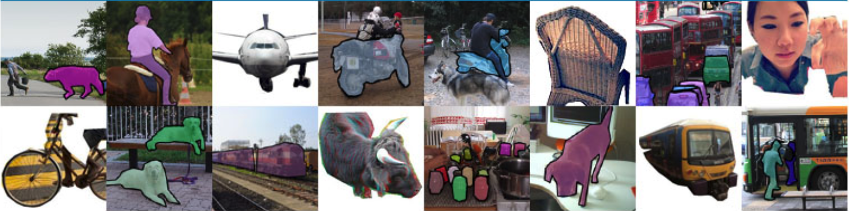
Data
Training Data: Microsoft COCO dataset
What is COCO?
Dataset examples
330K images (>200K labeled)
1.5 million object instances
80 categories
......
Notes:
COCO is a large-scale object detection, segmentation, and captioning dataset. COCO has several features: Object segmentation
Recognition in context
Superpixel stuff segmentation
330K images (>200K labeled)
1.5 million object instances
80 object categories
91 stuff categories
5 captions per image
250,000 people with keypoints
http://cocodataset.org/#home

Slide 5
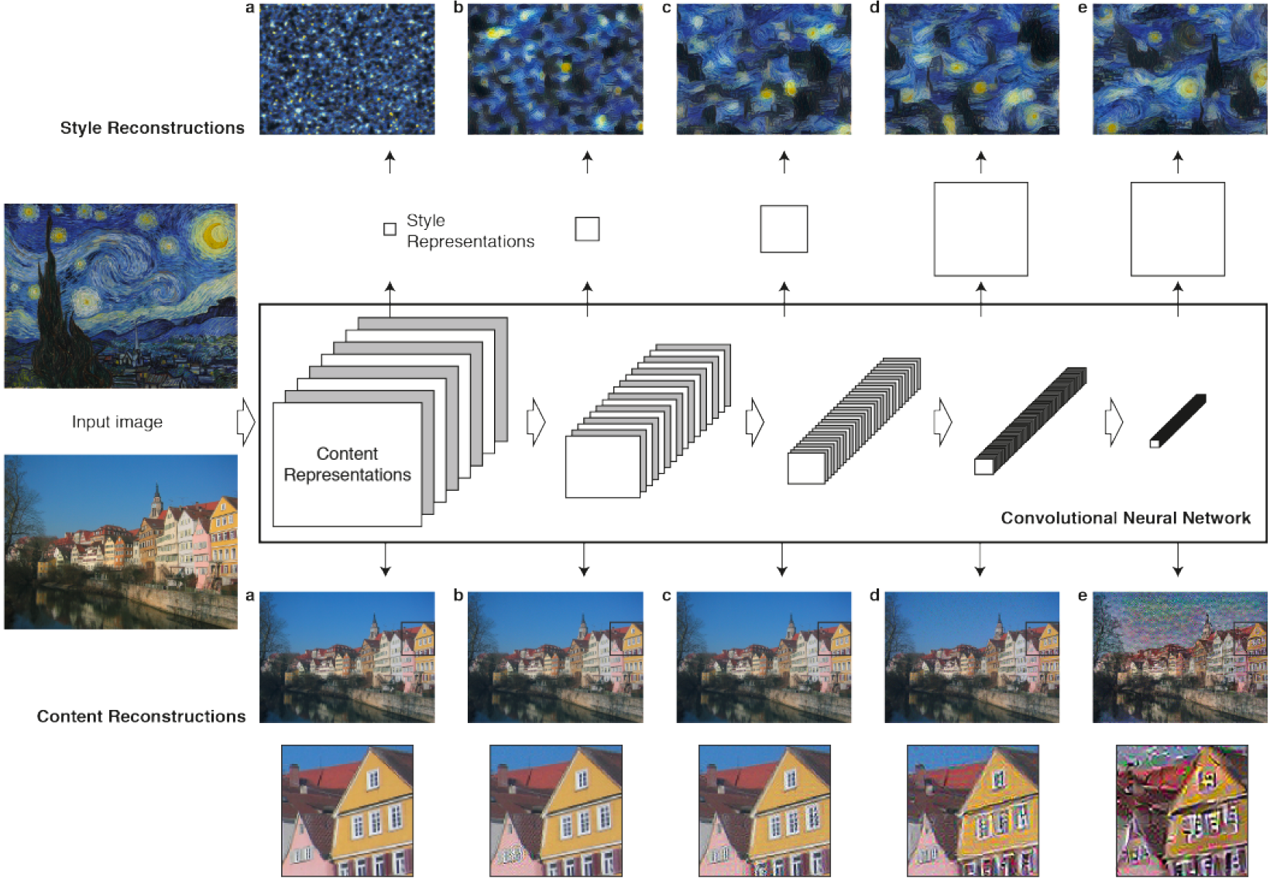

Publications & Methods
A Neural Algorithm of Artistic Style(2015)
Stationary, multi-scale representation:
Style representation
Key finding:
The representations of content and style in the CNN are separable
Convolutional
Neural
Network
(CNN)
Higher layers:
content representation
Notes:
Neural Style Transfer first released in the paper "A Neural Algorithm of Artistic Style” in 2015.
The core innovation of this paper is the use of deep learning to separate the content representation of an image, from the style representation.
The convolutional neural networks is applied here. It consists a batch of layers. Each layer of units can be considered as a collection of image filters. Every filter would extract a certain features from the input image.
Higher layers in the network capture the high-level content, like the objects and their arrangement, but not the exact pixel values. We therefore refer to the feature responses in higher layers of the network as content representation.
To obtain the representation of the style of the input image, we can use a feature space to capture texture information. This feature space is built on top of the filter responses in each layer of the network. It consists of the correlations between the different filter responses. By including the correlations of multiple layers, we can obtain a stationary, multi-scale representation of the input image, that is the style representation.
And during training process, we minimize the loss function contains two part separately, one part is content loss and another is style loss. Thus, the model can smoothly regulate the emphasis on either reconstructing the content or the style.
—————————————————————
For our project, after we finish the work above, we consider more possibilities. Like a real-time style transfer. It combines the technique above and another technique (that uses perceptual loss functions to generate high-quality images) together to make the algorithm three orders of magnitude faster.
If possible, we may try more advanced models and methods based on our prior work.

Slide 6
Publications & Methods – Cont.
More work may be included:
Perceptual Losses for Real-Time Style Transfer and Super-Resolution(2016)
Unpaired Image-to-Image Translation using Cycle-Consistent Adversarial Networks(2017)
Notes:
high-quality images can be generated by defining and optimizing perceptual loss functions based on high-level features extracted from pretrained networks, three orders of magnitude faster

Slide 7
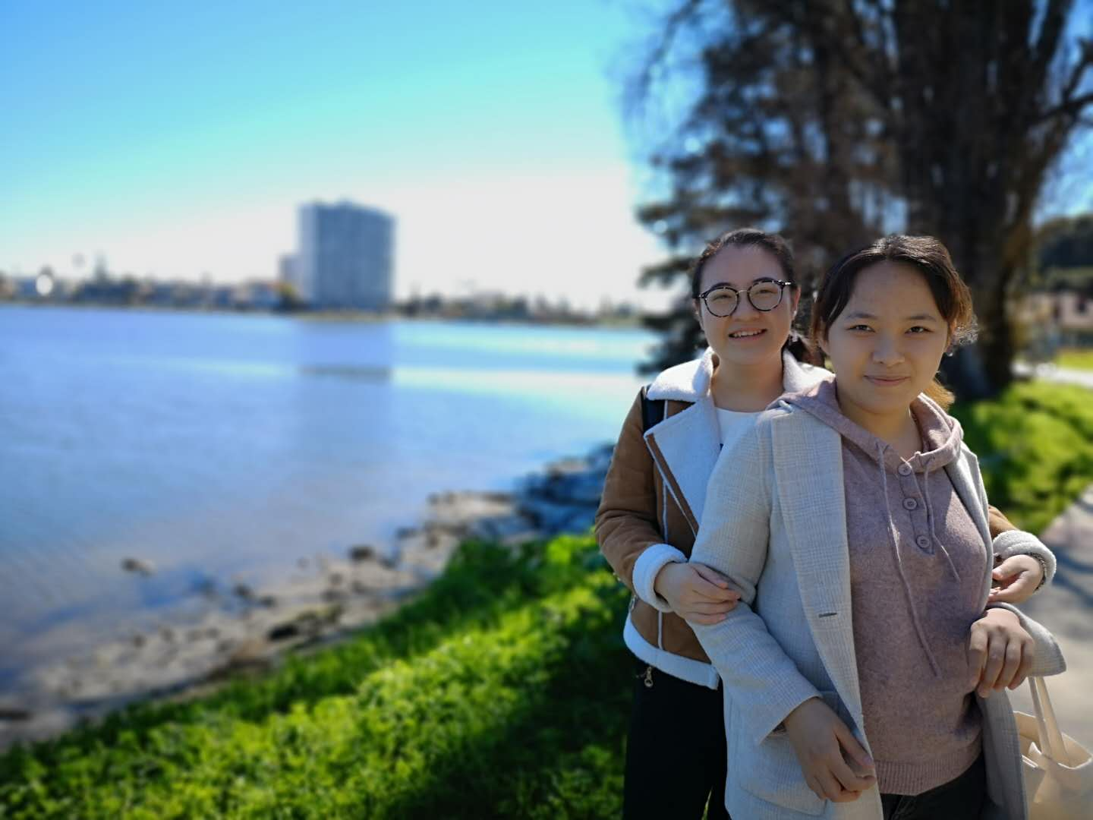

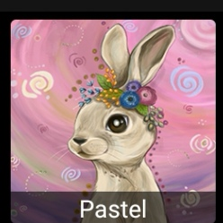


Results

Slide 8
Thank you!

